Slide 1

Hybrid Driven Framework in Selenium

Slide 2

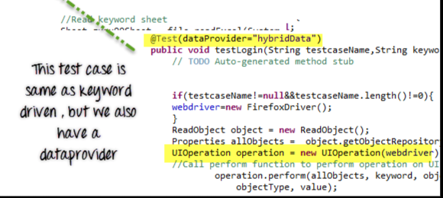
Introduction
Hybrid Test framework is a concept where using the advantage of both Keyword and Data driven framework.
Here for keywords, use Excel files to maintain test cases and for test data, use data provider of Testng framework.

Slide 3
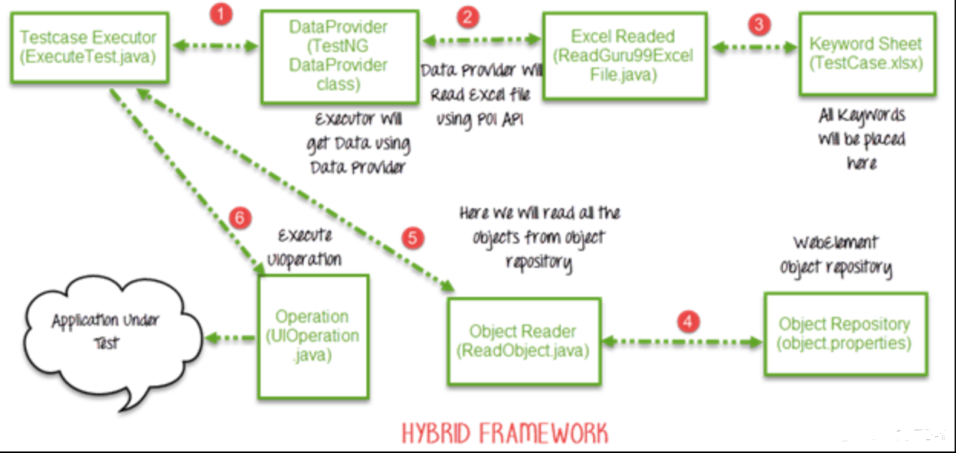

Slide 4
Procedure to implement Hybrid driven framework
Example:-
Executing 2 test cases
1) Test Case 1:-
a) Go to Base URL
b)Enter User ID
c)Enter Password
d)Click Reset
2) Test Case 2:-
a)Go to Base URL
b)Enter User ID
c)Enter Password
d)Click Login

Slide 5
Now see the code here:-ReadExcelFile.java
package excelExportAndFileIO;
import java.io.File;
import java.io.FileInputStream;
import java.io.IOException;
import org.apache.poi.hssf.usermodel.HSSFWorkbook;
import org.apache.poi.ss.usermodel.Sheet;
import org.apache.poi.ss.usermodel.Workbook;
import org.apache.poi.xssf.usermodel.XSSFWorkbook;
public class ReadExcelFile {
public Sheet readExcel(String filePath,String fileName,String sheetName) throws IOException{
//Create a object of File class to open xlsx file
File file = new File(filePath+"\\"+fileName);
//Create an object of FileInputStream class to read excel file
FileInputStream inputStream = new FileInputStream(file);
Workbook RWorkbook = null;
//Find the file extension by spliting file name in substing and getting only extension name
String fileExtensionName = fileName.substring(fileName.indexOf("."));

Slide 6
//Check condition if the file is xlsx file
if(fileExtensionName.equals(".xlsx"))
{
//If it is xlsx file then create object of XSSFWorkbook class
RWorkbook = new XSSFWorkbook(inputStream);
}
//Check condition if the file is xls file
else if(fileExtensionName.equals(".xls"))
{
//If it is xls file then create object of XSSFWorkbook class
RWorkbook = new HSSFWorkbook(inputStream);
}
//Read sheet inside the workbook by its name
Sheet RSheet = RWorkbook.getSheet(sheetName);
return RSheet;
}
}

Slide 7
Now see the code here:-ReadObject.java
package operation;
import java.io.File;
import java.io.FileInputStream;
import java.io.IOException;
import java.io.InputStream;
import java.util.Properties;
public class ReadObject
{
Properties p = new Properties();
public Properties getObjectRepository() throws IOException
{
//Read object repository file
InputStream stream = new FileInputStream(new File(System.getProperty("user.dir")+"\\src\\objects\\object.properties"));
//load all objects
p.load(stream);
return p;
}
}

Slide 8
Now see the code here:-UIOperation.java
package operation;
import java.util.Properties;
import org.openqa.selenium.By;
import org.openqa.selenium.WebDriver;
public class UIOperation {
WebDriver driver;
public UIOperation(WebDriver driver)
{
this.driver = driver;
}
public void perform(Properties p,String operation,String objectName,String objectType,String value) throws Exception{
System.out.println("");
switch (operation.toUpperCase()) {
case "CLICK":
//Perform click
driver.findElement(this.getObject(p,objectName,objectType)).click();
break;

Slide 9
case "SETTEXT":
//Set text on control
driver.findElement(this.getObject(p,objectName,objectType)).sendKeys(value);
break;
case "GOTOURL":
//Get url of application
driver.get(p.getProperty(value));
break;
case "GETTEXT":
//Get text of an element
driver.findElement(this.getObject(p,objectName,objectType)).getText();
break;
default:
break;
} }
/** * Find element BY using object type and value
* @param p
* @param objectName
* @param objectType
* @return
* @throws Exception */

Slide 10
private By getObject(Properties p,String objectName,String objectType) throws Exception{//Find by xpath
if(objectType.equalsIgnoreCase("XPATH")){
return By.xpath(p.getProperty(objectName)); }
//find by class
else if(objectType.equalsIgnoreCase("CLASSNAME")){
return By.className(p.getProperty(objectName)) }
//find by name
else if(objectType.equalsIgnoreCase("NAME")){
return By.name(p.getProperty(objectName)) }
//Find by css
else if(objectType.equalsIgnoreCase("CSS")){
return By.cssSelector(p.getProperty(objectName)); }
//find by link
else if(objectType.equalsIgnoreCase("LINK")){
return By.linkText(p.getProperty(objectName));}
//find by partial link
else if(objectType.equalsIgnoreCase("PARTIALLINK")){
return By.partialLinkText(p.getProperty(objectName));}
else{
throw new Exception("Wrong object type");
} } }

Slide 11
Now see the code here:-HybridExecuteTest.java
package testCases;
import java.io.IOException;
import java.util.Properties;
import operation.ReadObject;
import operation.UIOperation;
import org.apache.poi.ss.usermodel.Row;
import org.apache.poi.ss.usermodel.Sheet;
import org.openqa.selenium.WebDriver;
import org.openqa.selenium.firefox.FirefoxDriver;
import org.testng.annotations.DataProvider;
import org.testng.annotations.Test;
import excelExportAndFileIO.ReadExcelFile;
public class HybridExecuteTest {
WebDriver webdriver = null;
@Test(dataProvider="hybridData")
public void testLogin(String testcaseName,String keyword,String objectName,String objectType,String value) throws Exception {
// TODO Auto-generated method stub

Slide 12
if(testcaseName!=null&&testcaseName.length()!=0)
{
webdriver=new FirefoxDriver();
}
ReadObject object = new ReadObject();
Properties allObjects = object.getObjectRepository();
UIOperation operation = new UIOperation(webdriver);
//Call perform function to perform operation on UI
operation.perform(allObjects, keyword, objectName,objectType, value);
}
@DataProvider(name="hybridData")
public Object[ ][ ] getDataFromDataprovider() throws IOException
{
Object[ ][ ] object = null;
ReadExcelFile file = new ReadExcelFile();
//Read keyword sheet
Sheet RSheet = file.readExcel(System.getProperty("user.dir")+"\\","TestCase.xlsx" , "KeywordFramework");
//Find number of rows in excel file
int rowCount = RSheet.getLastRowNum()-RSheet.getFirstRowNum();
object = new Object[rowCount][5];

Slide 13
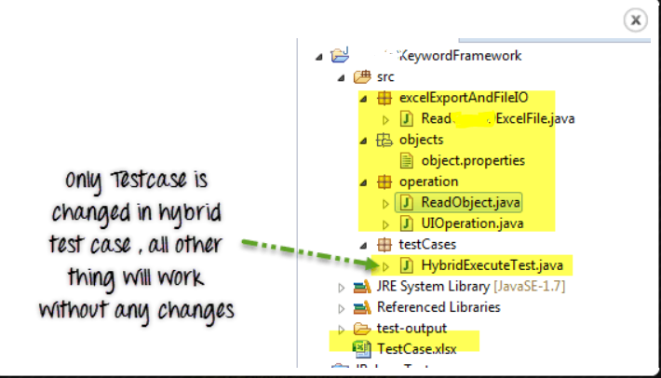
Now see Project explorer window look like this:-
for (int i = 0; i < rowCount; i++) {
//Loop over all the rows
Row row = RSheet.getRow(i+1);
//Create a loop to print cell values in a row
for (int j = 0; j < row.getLastCellNum(); j++)
{
//Print excel data in console
object[i][j] = row.getCell(j).toString();
}
}
System.out.println("");
return object;
}
}

Slide 14
Covered Till Now
The hybrid framework is a mix of keyword driven and data driven framework.
Here for keywords, use Excel files to maintain test cases and for test data, use data provider of Testng framework.

Slide 15
Thanks

